Slide 1


Title: What makes volcanoes hazardous?
LO: Analyse different volcanic hazards in order to assess which is most dangerous
Date: Thursday 16th October 2025
Title: What makes volcanoes hazardous?
Last Lesson: What 4 pieces of evidence did Wegener use to support his idea of continental drift?
Last Lesson: How do convection currents cause tectonic plates to move?
Two Weeks: What is the difference between a destructive plate boundary and a collision plate boundary?

Slide 2



Title: What makes volcanoes hazardous?
LO: Analyse different volcanic hazards in order to assess which is most dangerous
Keywords:
Active volcanoes 活火山 |  | These are volcanoes that have erupted (喷发) recently and are likely to erupt again. There are more than 700 active volcanoes around the world.
Dormant volcanoes休眠火山 |  | These have not erupted for a long time but could erupt again in the future.
Extinct volcanoes死火山 |  | These have not erupted for thousands of years and are not expected to erupt again.

Slide 3
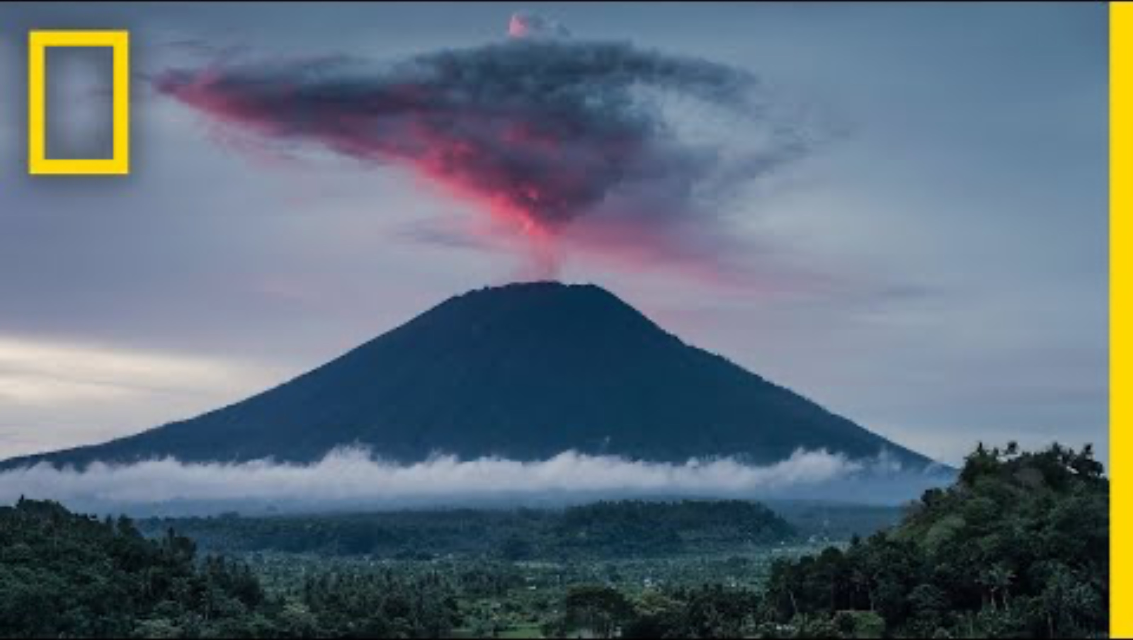
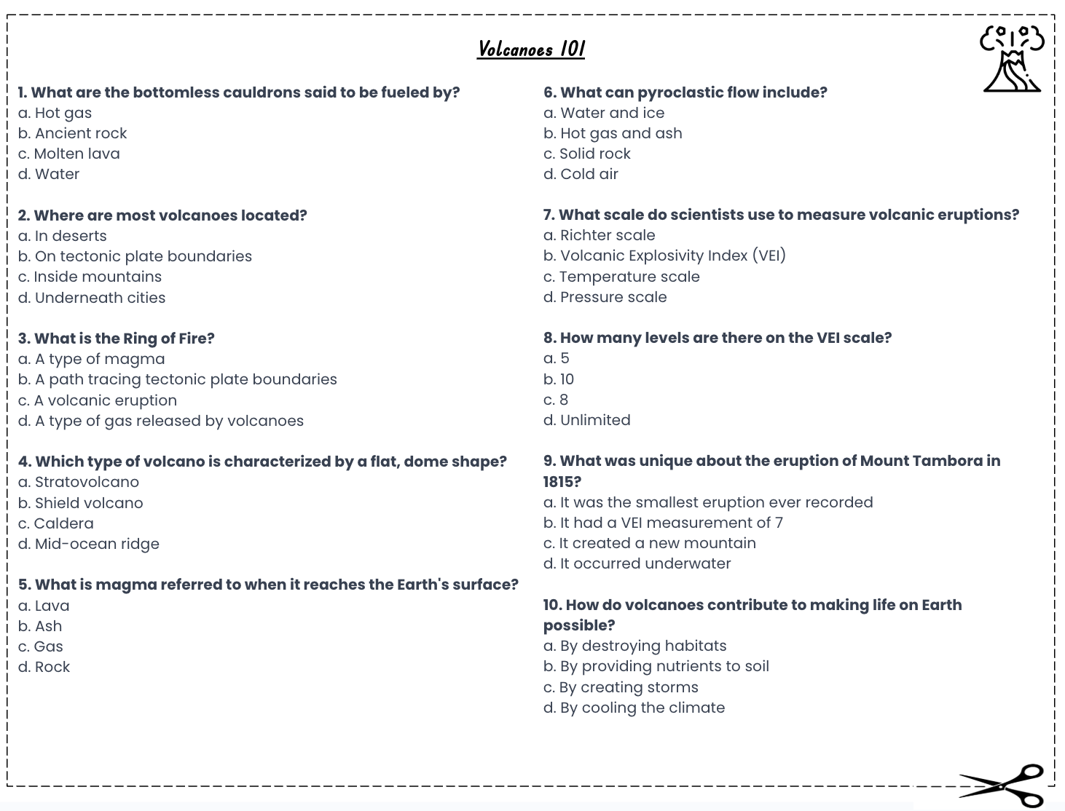
Title: What makes volcanoes hazardous?
LO: Analyse different volcanic hazards in order to assess which is most dangerous
Volcanoes 101
Activity: Complete the multiple choice questions whilst watching the video:
Volcanoes 101
Notes:
https://www.youtube.com/watch?v=VNGUdObDoLk

Slide 4
Title: What makes volcanoes hazardous?
LO: Analyse different volcanic hazards in order to assess which is most dangerous
Volcanoes 101
b. Ancient rock
c. On tectonic plate boundaries
d. A path tracing tectonic plate boundaries
b. Shield volcano
a. Lava
c. Hot gas and ash
d. Volcanic Explosivity Index (VEI)
d. Unlimited
b. It had a VEI measurement of 7
a. By providing nutrients to soil
GREEN PEN YOUR ANSWERS
Notes:
https://wayground.com/admin/quiz/68f0851ff3cd7371bc1edb0a/edit?at=68f0857376c361d2f8f590ae

Slide 5
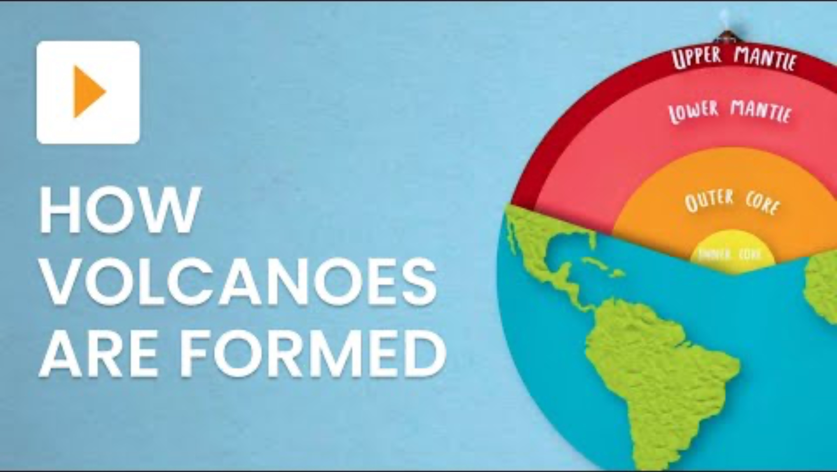
Title: What makes volcanoes hazardous?
LO: Analyse different volcanic hazards in order to assess which is most dangerous
Types of Volcanoes
What are the two main types of volcanoes, and where are they usually found?
Why do composite volcanoes have layers of ash and lava, and what is another name for them?
How are shield volcanoes different from composite volcanoes in shape and eruption style?
The two main types of volcanoes are composite volcanoes, found on destructive plate margins, and shield volcanoes, found on constructive plate margins or hot spots.
Composite volcanoes have layers of ash and lava because each eruption deposits lava and ash, and they are also called stratovolcanoes.
Shield volcanoes have gentle slopes and erupt less violently with runny lava, while composite volcanoes have steep slopes and erupt more violently.
Notes:
https://www.youtube.com/watch?v=R_pDKyg5YKY&t=248s

Slide 6

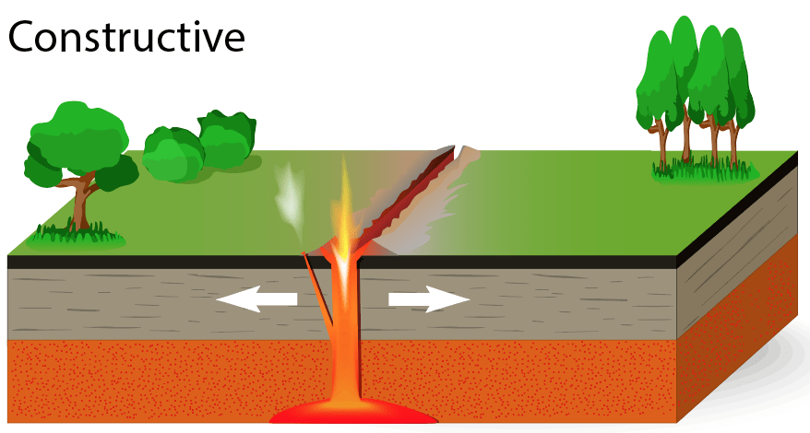
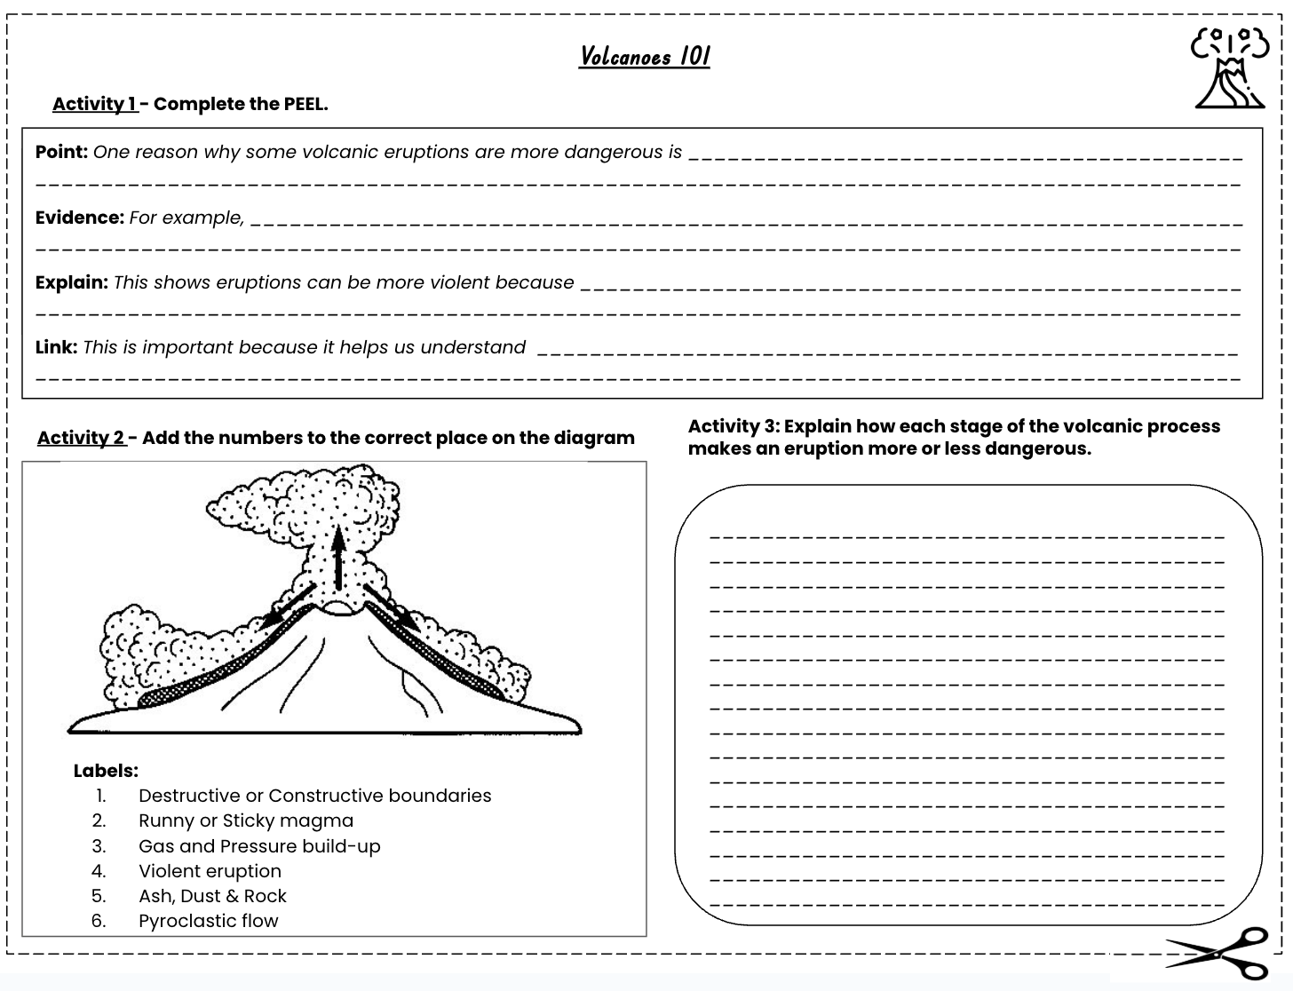
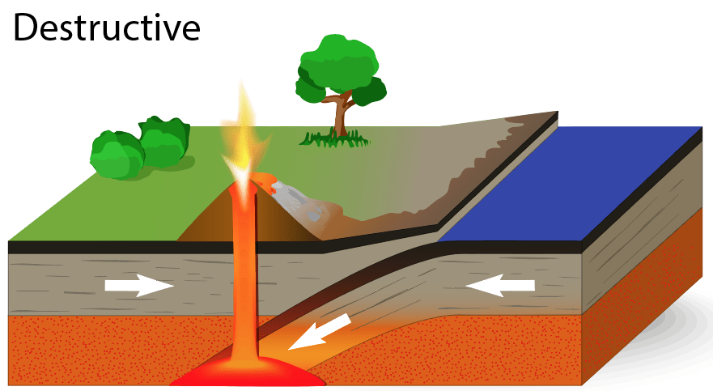


Title: What makes volcanoes hazardous?
LO: Analyse different volcanic hazards in order to assess which is most dangerous
Volcanoes 101
Activity 1 - Complete the PEEL explaining why some volcanic eruptions more dangerous than others.
Plate Boundaries
Activities on sheet
Activity 2 - Add the numbers to the correct place on the diagram.
Activity 3 - Explain how each stage of the volcanic process (plate boundaries, magma type, gas and pressure, eruption type, eruption materials, and pyroclastic flow) makes an eruption more or less dangerous.
Compare a volcano with runny magma and low gas to one with thick magma and trapped gas. Predict how their eruptions would differ in strength, danger and the hazards for people nearby.

Slide 7
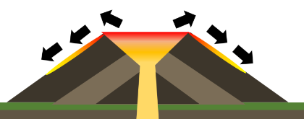
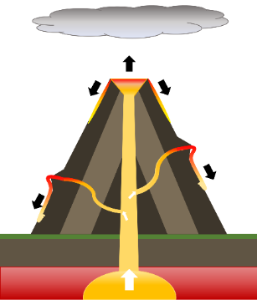
Title: What makes volcanoes hazardous?
LO: Analyse different volcanic hazards in order to assess which is most dangerous
Types of Volcanoes
Activity 4 – Read the information sheet and annotate the diagrams to show the key features of the composite and shield volcanoes.
Shield
Key Feature Annotations:
Slopes – Gentle / Steep
Base width – Wide / Narrow
Lava type – Thin/runny / Thick/sticky
Lava flow speed – Fast / Slow
Eruption style – Gentle / Violent
Crater – Large / Small
Volcanic bombs – None / Often
Number of vents – One / Several
Composite
Notes:
https://www.youtube.com/watch?v=VNGUdObDoLk

Slide 8
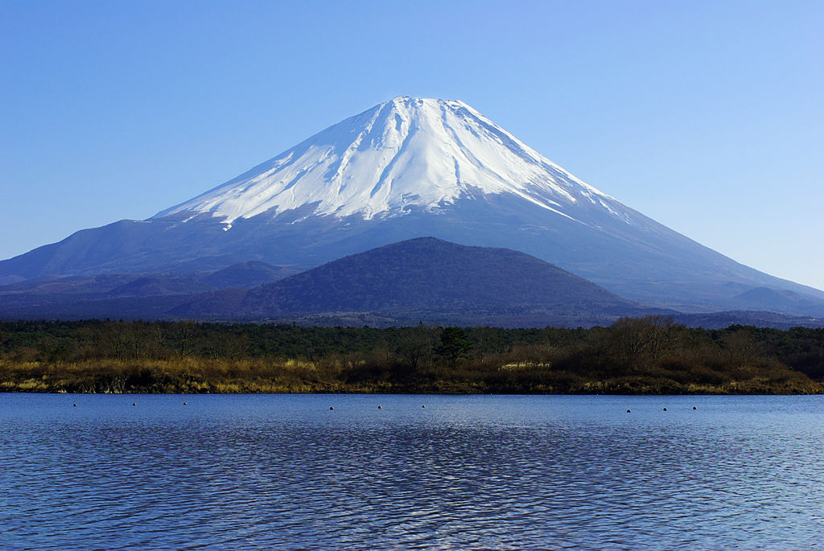
Title: What makes volcanoes hazardous?
LO: Analyse different volcanic hazards in order to assess which is most dangerous
Key Feature Annotations:
Slopes – Gentle / Steep
Base width – Wide / Narrow
Lava type – Thin/runny / Thick/sticky
Lava flow speed – Fast / Slow
Eruption style – Gentle / Violent
Crater – Large / Small
Volcanic bombs – None / Often
Number of vents – One / Several
Composite - Mt Fuji, Japan
Activity 5: - Describe Mount Fuji’s main features and explain why it is potentially dangerous for the people who live nearby.
Write your answer in 2 PEEL paragraphs with each paragraph focusing on one potential hazard if Mount Fuji erupts.
Hazards: - lava type, lava flow speed, eruption style, crater, volcanic bombs & vents.
Notes:
https://www.youtube.com/watch?v=VNGUdObDoLk

Slide 9


PEEL Structure for Mount Fuji
Point
Mt. Fuji is dangerous because…
People living at Mt. Fuji are at risk because…
Evidence
For example, a potential hazard if Mount Fuji erupts is… (choose from the list)
Another potential hazard is… (choose from the list)
Explain
This is dangerous because…
As a result, people/buildings…
Link
Therefore, Mount Fuji is a serious danger to…
This shows that Mount Fuji is potentially harmful to people and buildings because…
Make a clear statement about why Mount Fuji is dangerous.
Use two of the key features (from the list) to describe Mount Fuji.
Explain why those features make it dangerous for people or buildings.
Link back to the overall question about Mount Fuji’s dangers.
Make your paragraph Extra Hot by adding in the values people living near Mount Fuji might need to show.
(E.g. Resilience, preparedness, or responsibility).

Slide 10
富士山PEEL结构 要点 富士山危险是因为...... 住在富士山的人正处于危险之中，因为...... 证据 比如，如果富士山爆发，潜在的危险是......（从列表中选择） 另一个潜在危险是......（从列表中选择） 解释一下 这很危险，因为...... 因此，人们和建筑...... 链接 因此，富士山对...... 这表明富士山对人和建筑都有潜在的危害，因为......
Make a clear statement about why Mount Fuji is dangerous.
Use two of the key features (from the list) to describe Mount Fuji.
Explain why those features make it dangerous for people or buildings.
Link back to the overall question about Mount Fuji’s dangers.
Make your paragraph Extra Hot by adding in the values people living near Mount Fuji might need to show.
(E.g. Resilience, preparedness, or responsibility).

Slide 11

Title: What makes volcanoes hazardous?
LO: Analyse different volcanic hazards in order to assess which is most dangerous
Odd One Out
What is one main reason shield volcanoes are usually less dangerous than composite volcanoes?
A) Their lava is runny and flows gently away
B) They explode violently with lots of gas
C) They trap sticky lava and ash inside
D) They always form very tall cone shapes
What value do people show when they prepare for eruptions, even if the volcano is usually gentle?
Notes:
https://dashboard.blooket.com/set/68b116266e3af35fc52bd327

Slide 12
Title: What makes volcanoes hazardous?
LO: Analyse different volcanic hazards in order to assess which is most dangerous
Odd One Out
What is one main reason composite volcanoes can cause more destruction?
A) They have gentle slopes and thin lava
B) Their sticky lava traps gas, causing violent eruptions
C) They only produce harmless steam and smoke
D) They never release ash or volcanic bombs
What value is important for scientists studying dangerous volcanoes so they can protect others?
Notes:
https://dashboard.blooket.com/set/68b116266e3af35fc52bd327

Slide 13
Title: What makes volcanoes hazardous?
LO: Analyse different volcanic hazards in order to assess which is most dangerous
Odd One Out
What happens when lots of gas and pressure build up inside a volcano?
A) A slow, gentle lava flow moves safely away
B) The volcano stays quiet and inactive
C) An explosive eruption blasts out ash and rocks
D) The magma cools before reaching the surface
What value do communities need when they have to evacuate quickly and follow safety rules?
Notes:
https://dashboard.blooket.com/set/68b116266e3af35fc52bd327

Slide 14

Title: What makes volcanoes hazardous?
LO: Analyse different volcanic hazards in order to assess which is most dangerous
Odd One Out
What is one main reason pyroclastic flows are so deadly?
A) They move slowly so people can escape
B) They are made of harmless steam
C) They are fast, hot clouds of gas and ash that burn everything in their path
D) They only happen far away from towns and cities
What value do rescuers show when they risk their lives to help people after an eruption?
Notes:
https://dashboard.blooket.com/set/68c0c9d693edbe01bde4a622

